Slide 1
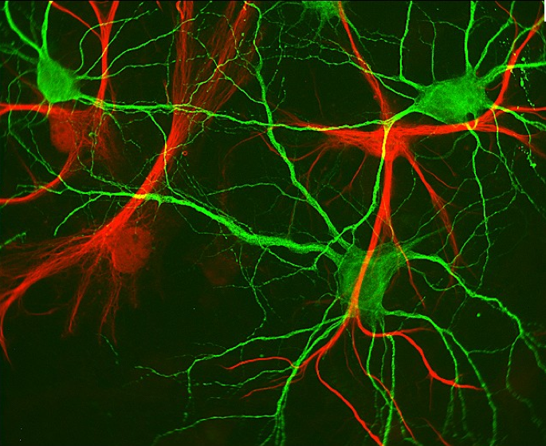
Neurons

Slide 2
Neurons: Types
3 main types:
Sensory neurons
Have afferent projections
Bring in sensory information from outside world to brain
Motor neurons
Have efferent projections
Transmit signals from brain to muscles
Interneurons
Communication within brain (local interneurons communicate within a given brain structure)

Slide 3
Neurons: Structure and Function
4 main structures:
Dendrites
Cell body (soma)
Axon
Terminal Boutons (buttons)

Slide 4
Neurons: Structure and Function
1. Dendrites
extend from soma like branches
receive information from other neurons (i.e., the “antennae” of the system)
covered with receptors (protein molecules that detect neurotransmitters)

Slide 5
Neurons: Structure and Function
2. Soma (cell body)
Contains organelles (nucleus, mitochondria, endoplasmic reticulum, golgi apparatus)
Site of protein synthesis, energy production for cell activity, integration of signals

Slide 6
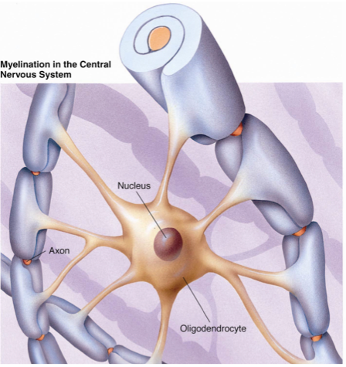
Neurons: Structure and Function
3. Axon
Long narrow outgrowth
carries electrical signals over long distances within the nervous system (i.e. the wires of the system)
encased by myelin sheath
Formed by glial cells
Enhances speed of signal conductance
Nodes of Ranvier: segments of axon not encased by myelin

Slide 7
Neurons: Structure and Function
4. Terminal Boutons (buttons)
region that makes contact with other neurons or cells (typically contacts dendrites of other neurons)
where the transfer of information occurs through the release of neurotransmitters

Slide 8
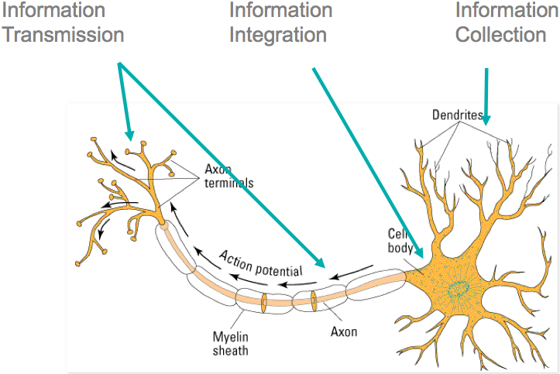
Neurons: Summary

Slide 9
Neurons: Resting Membrane Potential
Membrane potential: difference in voltage between inside and outside of cell
Due to separation of negative and positive ions across cell membrane
Resting membrane potential: membrane potential when neuron is not active
negative charge inside cell is higher than outside cell
Typically -70mV

Slide 10
Neurons: Action Potentials
Means of communication between neurons
Electrical signal that passes along the axon
Involves rapid changes in membrane potential:
Depolarization: membrane potential becomes more positive
Hyperpolarization: membrane potential becomes more negative
Caused by the movement of ions across the membrane

Slide 11
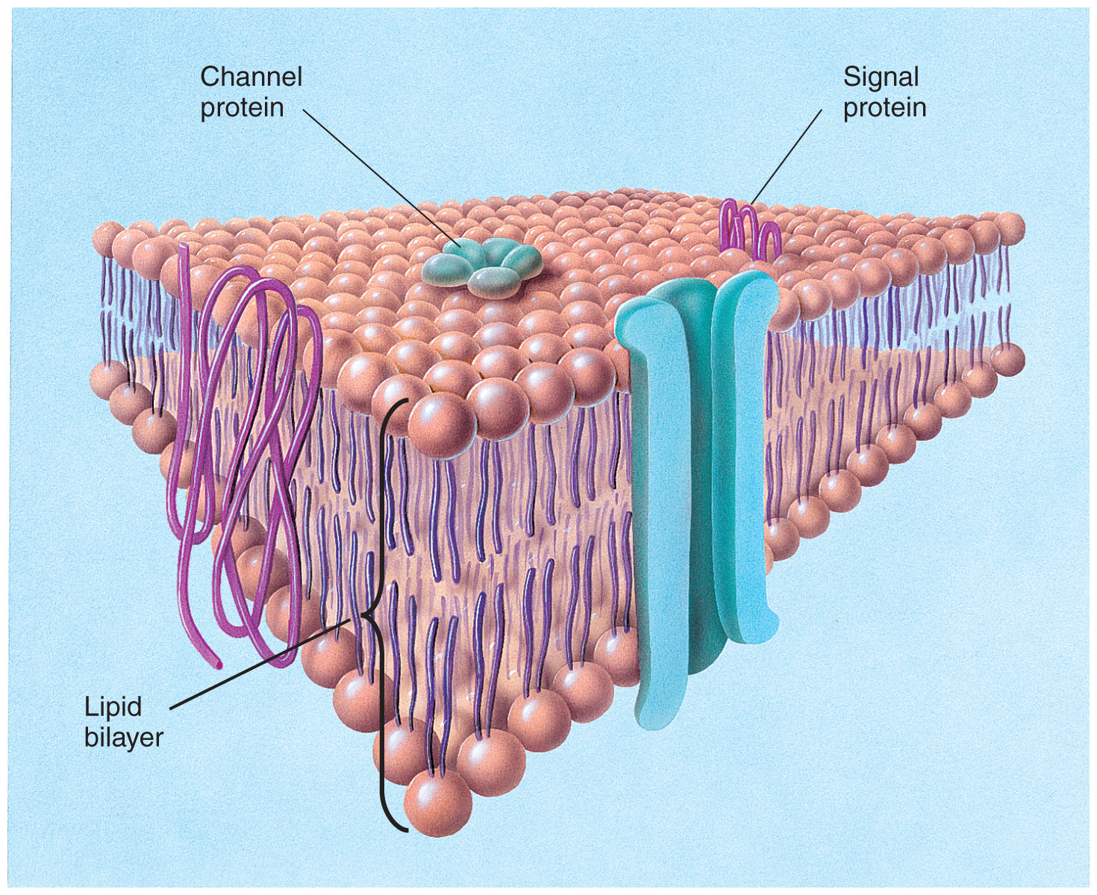
Neurons: Ion Channels
Are protein molecules located in the cell membrane
Contain a pore where ions pass through
Pore can be selective or non-selective for particular ions
Pore can be gated (need a specific signal to allow flow of ions)

Slide 12
Neurons: Voltage-Gated Ion Channels
Voltage-gated ion channels are important for action potential generation
The channel is only open when membrane potential reaches a certain voltage (threshold potential)
Ex. Voltage-gated Na+ channels are open when membrane potential is depolarized from -70mV to -50mV

Slide 13
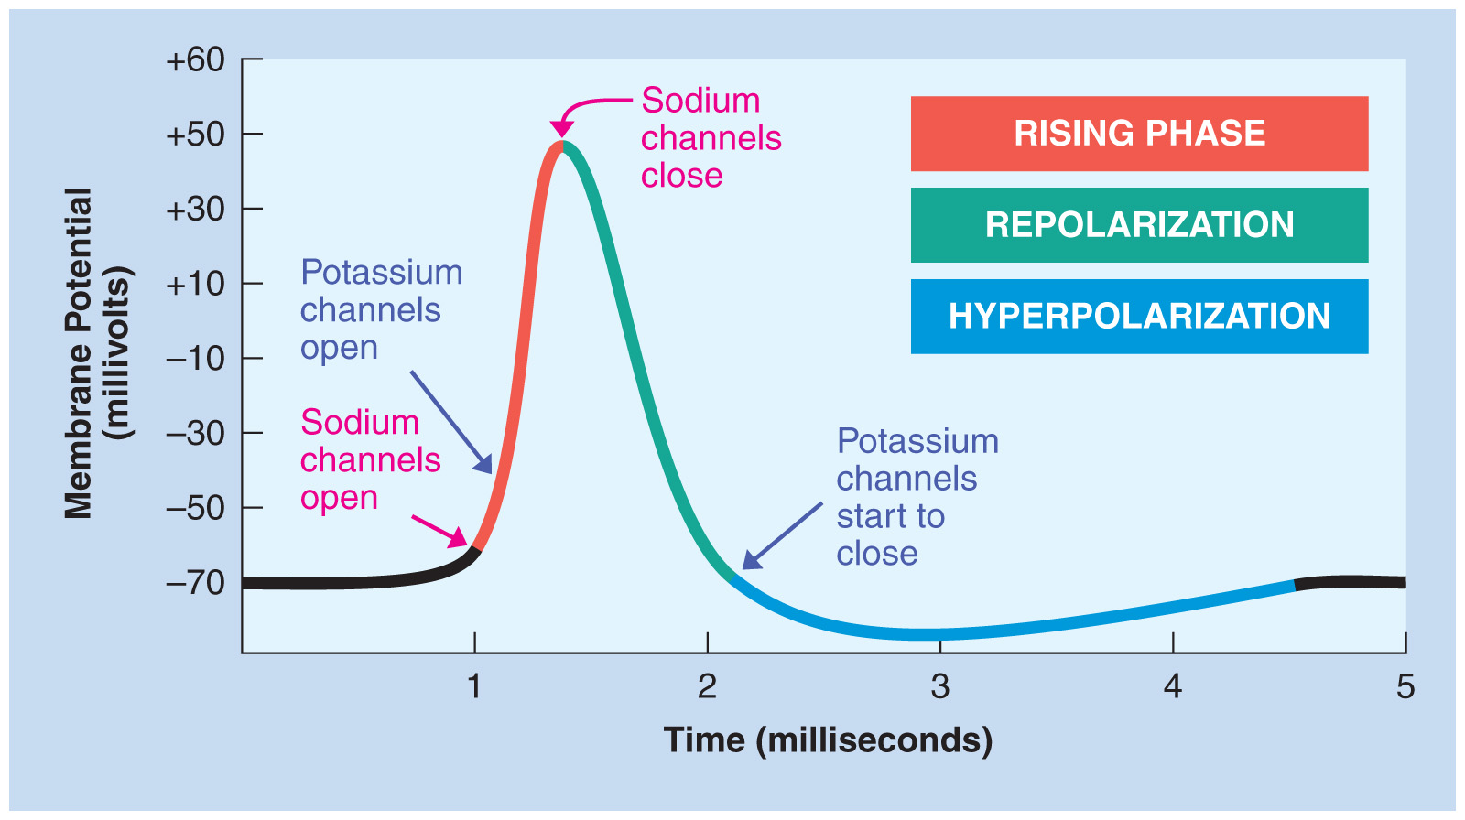
Neurons: Action Potentials
Dendrites receive signals from terminals of other neurons
If sufficient excitatory signals arrive then neuron will be depolarized to the threshold
Voltage-gated Na+ channels will open = Na+ enters cell = further depolarization
Voltage-gated K+ channels open slowly = K+ begins to exit cell
Na+ channels inactivate = no more Na+ entry, but continued K+ efflux= repolarization/hyperpolarization
K+ channels inactivate = return to resting membrane potential

Slide 14
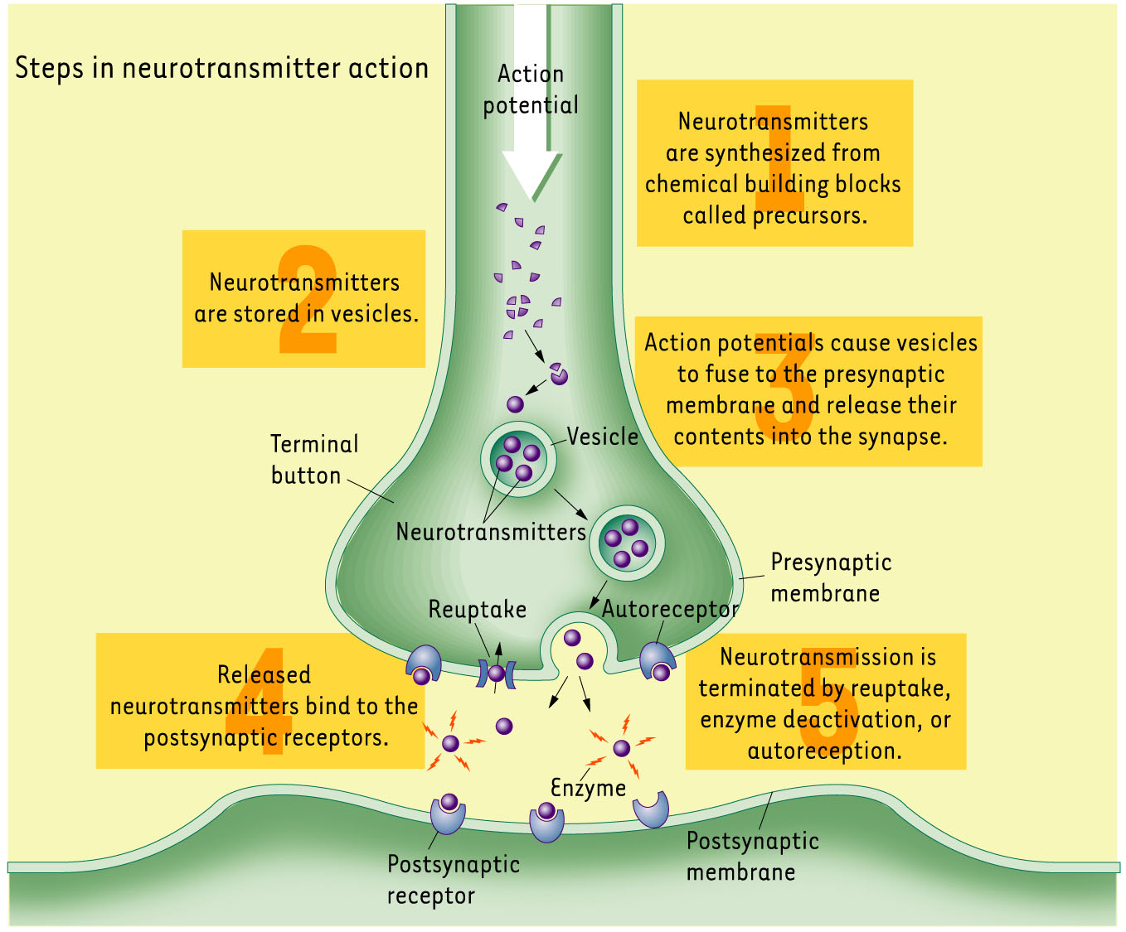
Neurotransmitter Release

Slide 15
Neurotransmitter Release
When action potential reaches terminals → neurotransmitter release
Vesicles containing neurotransmitters fuse to membrane terminal of presynaptic neuron
Neurotransmitters are released into synaptic cleft: space between terminal of presynaptic neuron and dendrite of postsynaptic neuron
Neurotransmitters bind to specific receptors located on dendrites of postsynaptic neuron
Signal is terminated once neurotransmitters are cleared from synaptic cleft by:
Enzyme deactivation
Reuptake into the presynaptic terminal through transporter proteins
Diffusion out of the synaptic cleft

Slide 16
Neurotransmitter Types
Achetylcholine
Motor control, attention, learning, sleep
Norepinephrine/Epinephrine
Alertness, vigilance, mobilizes energy reserves
Serotonin
Mood, aggression, impulse control
Dopamine
Motor control, motivation, reward processing
GABA
Primary inhibitory neurotransmitter (decreases action potential probability)
Glutamate
Primary excitatory neurotransmitter (increases action potential probability)

Slide 17
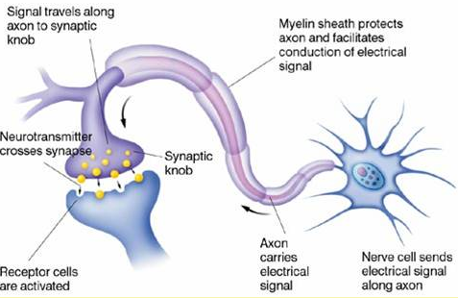
Summary of Neurotransmission

Slide 18
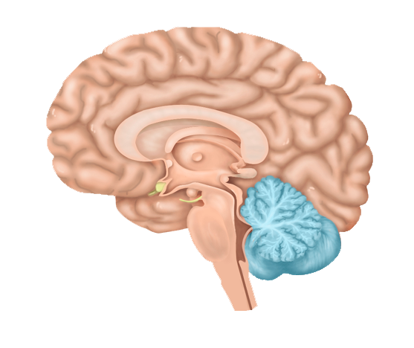
Major Brain Structures
Cerebellum (“little brain”):
fine motor control
balance

Slide 19
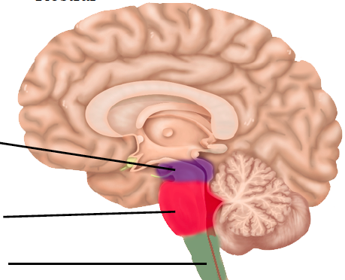
Major Brain Structures
Brainstem: areas for maintaining life and consciousness
Midbrain
Pons
Medulla

Slide 20
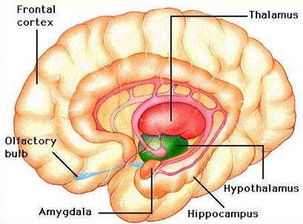
Major Brain Structures
Subcortical structures: emotions and basic drives
Hypothalamus
Thalamus
Amygdala
Hippocampus
Basal Ganglia

Slide 21
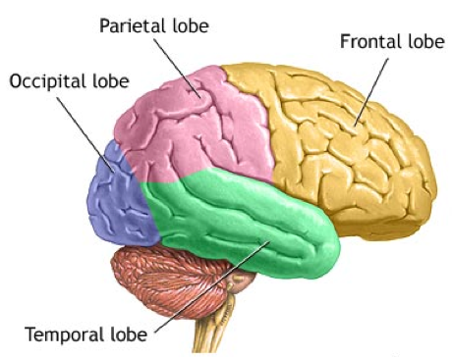
Major Brain Structures
Cerebral Cortex: complex mental activity
Occipital lobe
Parietal lobe
Temporal lobe
Frontal lobe

